Slide 1
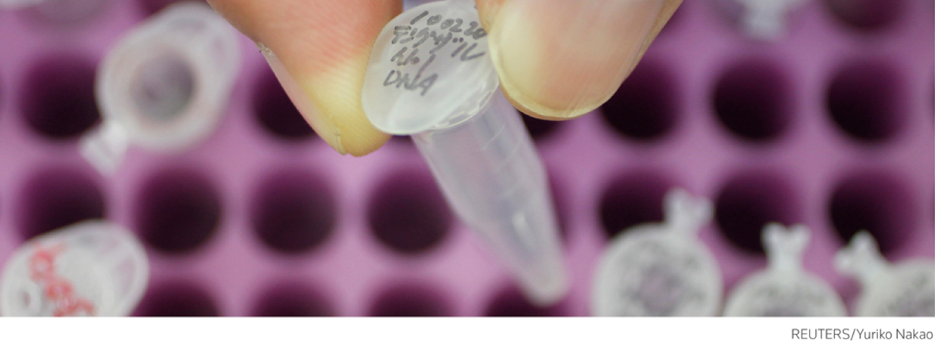

Web of Science助您走出科研制胜一步
王硕
汤森路透集团

Slide 2


SCI(Science Citation Index)的前世今生
Dr. Garfield 1955年在 Science 发表论文提出将引文索引作为一种新的文献检索与分类工具，将一篇文献作为检索字段从而跟踪一个“Idea”的发展过程
^{Synthesis of Amino Acids}
Synthesis and/or collection of Synthesis and/or collection of amino acids is critical for cell survival. They not only serve as the building blocks for proteins but also as starting points for the synthesis of many important cellular molecules including vitamins and nucleotides.
^{Synthesis of Amino Acids}
Synthesis and/or collection of Synthesis and/or collection of amino acids is critical for cell survival. They not only serve as the building blocks for proteins but also as starting points for the synthesis of many important cellular molecules including vitamins and nucleotides.
^{Synthesis of Amino Acids}
Synthesis and/or collection of Synthesis and/or collection of amino acids is critical for cell survival. They not only serve as the building blocks for proteins but also as starting points for the synthesis of many important cellular molecules including vitamins and nucleotides.
^{Synthesis of Amino Acids}
Synthesis and/or collection of Synthesis and/or collection of amino acids is critical for cell survival. They not only serve as the building blocks for proteins but also as starting points for the synthesis of many important cellular molecules including vitamins and nucleotides.
^{Synthesis of Amino Acids}
Synthesis and/or collection of Synthesis and/or collection of amino acids is critical for cell survival. They not only serve as the building blocks for proteins but also as starting points for the synthesis of many important cellular molecules including vitamins and nucleotides.
^{Synthesis of Amino Acids}
Synthesis and/or collection of Synthesis and/or collection of amino acids is critical for cell survival. They not only serve as the building blocks for proteins but also as starting points for the synthesis of many important cellular molecules including vitamins and nucleotides.
Dr. Eugene Garfield
Founder & Chairman Emeritus ISI, Thomson Scientific
“Our ultimate goal is to extend our retrospective coverage of the scientific literature back to the twentieth century. The Century of Science initiative makes that dream come true.”
^{Synthesis of Amino Acids}
Synthesis and/or collection of Synthesis and/or collection of amino acids is critical for cell survival. They not only serve as the building blocks for proteins but also as starting points for the synthesis of many important cellular molecules including vitamins and nucleotides.
^{Synthesis of Amino Acids}
Synthesis and/or collection of Synthesis and/or collection of amino acids is critical for cell survival. They not only serve as the building blocks for proteins but also as starting points for the synthesis of many important cellular molecules including vitamins and nucleotides.
^{Synthesis of Amino Acids}
Synthesis and/or collection of Synthesis and/or collection of amino acids is critical for cell survival. They not only serve as the building blocks for proteins but also as starting points for the synthesis of many important cellular molecules including vitamins and nucleotides.
^{Synthesis of Amino Acids}
Synthesis and/or collection of Synthesis and/or collection of amino acids is critical for cell survival. They not only serve as the building blocks for proteins but also as starting points for the synthesis of many important cellular molecules including vitamins and nucleotides.
^{Synthesis of Amino Acids}
Synthesis and/or collection of Synthesis and/or collection of amino acids is critical for cell survival. They not only serve as the building blocks for proteins but also as starting points for the synthesis of many important cellular molecules including vitamins and nucleotides.
^{Synthesis of Amino Acids}
Synthesis and/or collection of Synthesis and/or collection of amino acids is critical for cell survival. They not only serve as the building blocks for proteins but also as starting points for the synthesis of many important cellular molecules including vitamins and nucleotides.
^{Synthesis of Amino Acids}
Synthesis and/or collection of Synthesis and/or collection of amino acids is critical for cell survival. They not only serve as the building blocks for proteins but also as starting points for the synthesis of many important cellular molecules including vitamins and nucleotides.
^{Synthesis of Amino Acids}
Synthesis and/or collection of Synthesis and/or collection of amino acids is critical for cell survival. They not only serve as the building blocks for proteins but also as starting points for the synthesis of many important cellular molecules including vitamins and nucleotides.
^{Synthesis of Amino Acids}
Synthesis and/or collection of Synthesis and/or collection of amino acids is critical for cell survival. They not only serve as the building blocks for proteins but also as starting points for the synthesis of many important cellular molecules including vitamins and nucleotides.
^{Synthesis of Amino Acids}
Synthesis and/or collection of Synthesis and/or collection of amino acids is critical for cell survival. They not only serve as the building blocks for proteins but also as starting points for the synthesis of many important cellular molecules including vitamins and nucleotides.
^{Synthesis of Amino Acids}
Synthesis and/or collection of Synthesis and/or collection of amino acids is critical for cell survival. They not only serve as the building blocks for proteins but also as starting points for the synthesis of many important cellular molecules including vitamins and nucleotides.
^{Synthesis of Amino Acids}
Synthesis and/or collection of Synthesis and/or collection of amino acids is critical for cell survival. They not only serve as the building blocks for proteins but also as starting points for the synthesis of many important cellular molecules including vitamins and nucleotides.
^{Synthesis of Amino Acids}
Synthesis and/or collection of Synthesis and/or collection of amino acids is critical for cell survival. They not only serve as the building blocks for proteins but also as starting points for the synthesis of many important cellular molecules including vitamins and nucleotides.
^{Synthesis of Amino Acids}
Synthesis and/or collection of Synthesis and/or collection of amino acids is critical for cell survival. They not only serve as the building blocks for proteins but also as starting points for the synthesis of many important cellular molecules including vitamins and nucleotides.
^{Synthesis of Amino Acids}
Synthesis and/or collection of Synthesis and/or collection of amino acids is critical for cell survival. They not only serve as the building blocks for proteins but also as starting points for the synthesis of many important cellular molecules including vitamins and nucleotides.
^{Synthesis of Amino Acids}
Synthesis and/or collection of Synthesis and/or collection of amino acids is critical for cell survival. They not only serve as the building blocks for proteins but also as starting points for the synthesis of many important cellular molecules including vitamins and nucleotides.
^{Synthesis of Amino Acids}
Synthesis and/or collection of Synthesis and/or collection of amino acids is critical for cell survival. They not only serve as the building blocks for proteins but also as starting points for the synthesis of many important cellular molecules including vitamins and nucleotides.
^{Synthesis of Amino Acids}
Synthesis and/or collection of Synthesis and/or collection of amino acids is critical for cell survival. They not only serve as the building blocks for proteins but also as starting points for the synthesis of many important cellular molecules including vitamins and nucleotides.
^{Synthesis of Amino Acids}
Synthesis and/or collection of Synthesis and/or collection of amino acids is critical for cell survival. They not only serve as the building blocks for proteins but also as starting points for the synthesis of many important cellular molecules including vitamins and nucleotides.
^{Synthesis of Amino Acids}
Synthesis and/or collection of Synthesis and/or collection of amino acids is critical for cell survival. They not only serve as the building blocks for proteins but also as starting points for the synthesis of many important cellular molecules including vitamins and nucleotides.
^{Synthesis of Amino Acids}
Synthesis and/or collection of Synthesis and/or collection of amino acids is critical for cell survival. They not only serve as the building blocks for proteins but also as starting points for the synthesis of many important cellular molecules including vitamins and nucleotides.
^{Synthesis of Amino Acids}
Synthesis and/or collection of Synthesis and/or collection of amino acids is critical for cell survival. They not only serve as the building blocks for proteins but also as starting points for the synthesis of many important cellular molecules including vitamins and nucleotides.
^{Synthesis of Amino Acids}
Synthesis and/or collection of Synthesis and/or collection of amino acids is critical for cell survival. They not only serve as the building blocks for proteins but also as starting points for the synthesis of many important cellular molecules including vitamins and nucleotides.

Slide 3

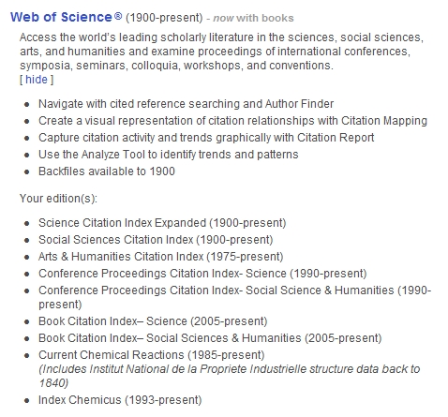
几经风雨，几经变迁
Web of Science的世界里，除了自然科学，还有社会科学、艺术与人文、会议记录、图书以及化学式和化学反应
现收录各领域顶尖杂志8000多本

Slide 4
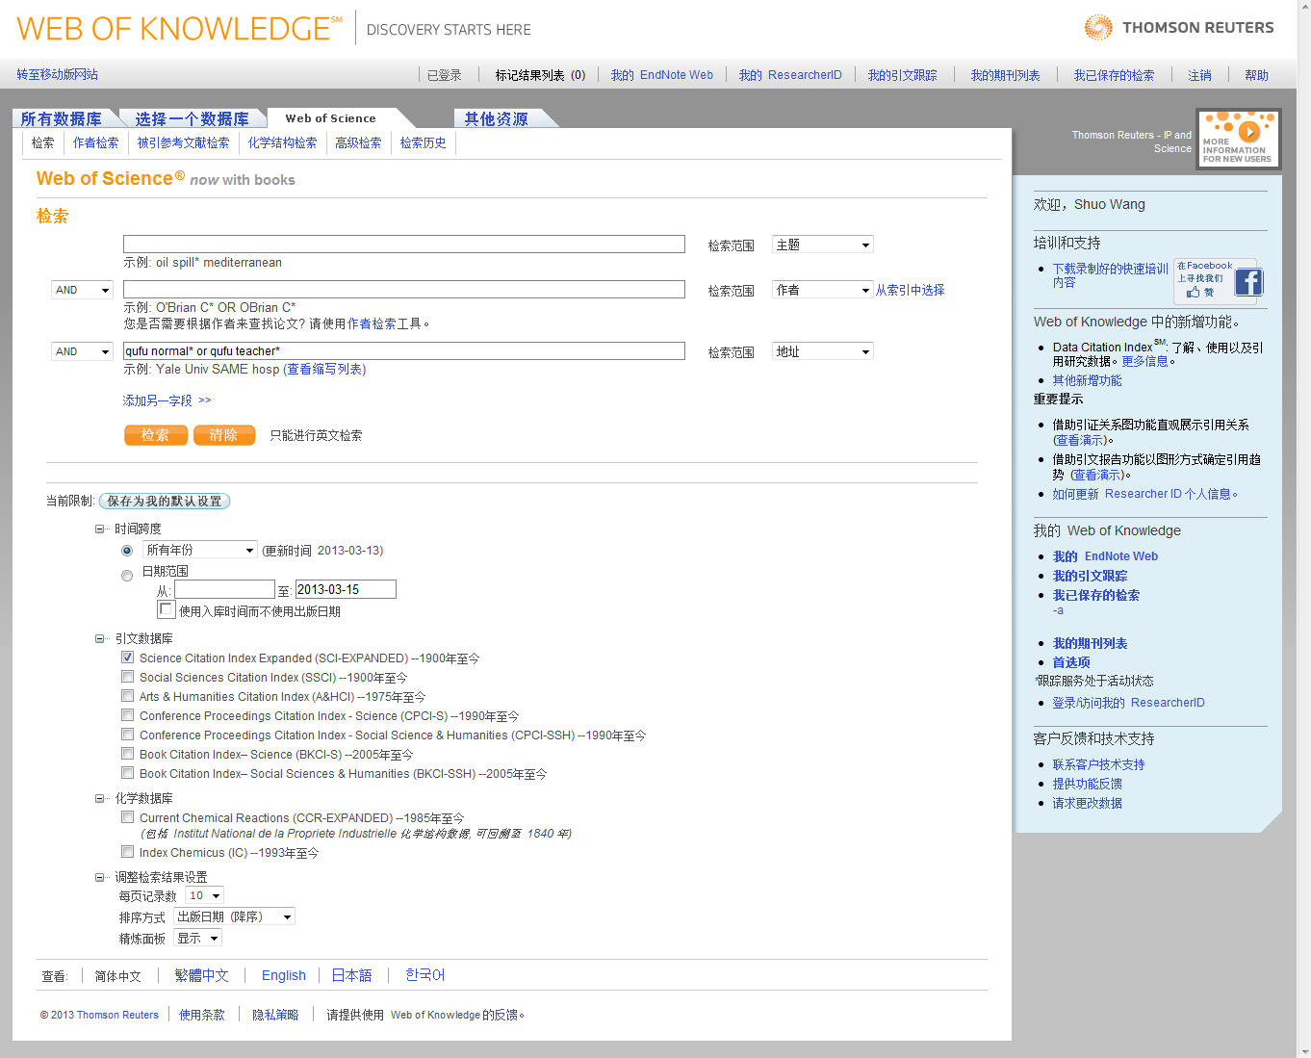
www.webofknowledge.com

Slide 5

Question1
Notes:
在我们点击搜索之前，那位同学知道到现在为止曲阜师范大学一共发表了多少篇论文被SCI收录，请三个同学回答，最接近的给个小礼品

Slide 6
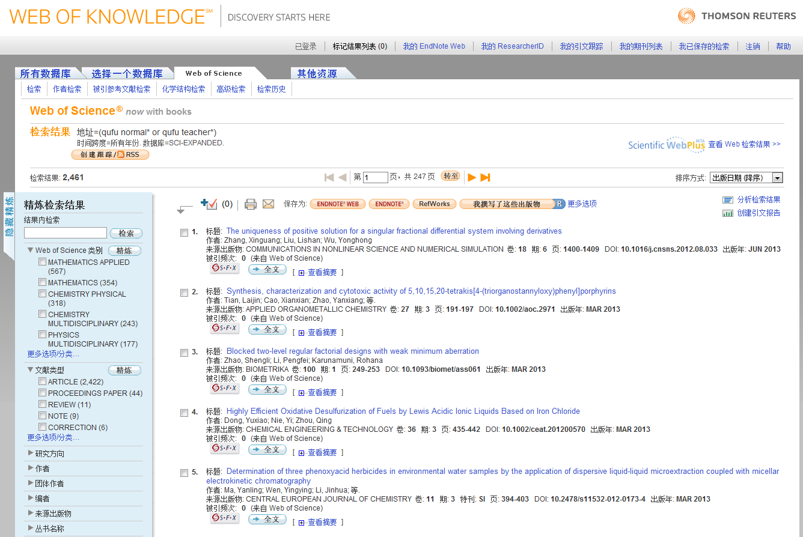
曲阜师范大学SCI论文总数/创建引文报告
1981-今，曲阜师范大学发表的论文中有近2461篇论文被SCI收录

Slide 7
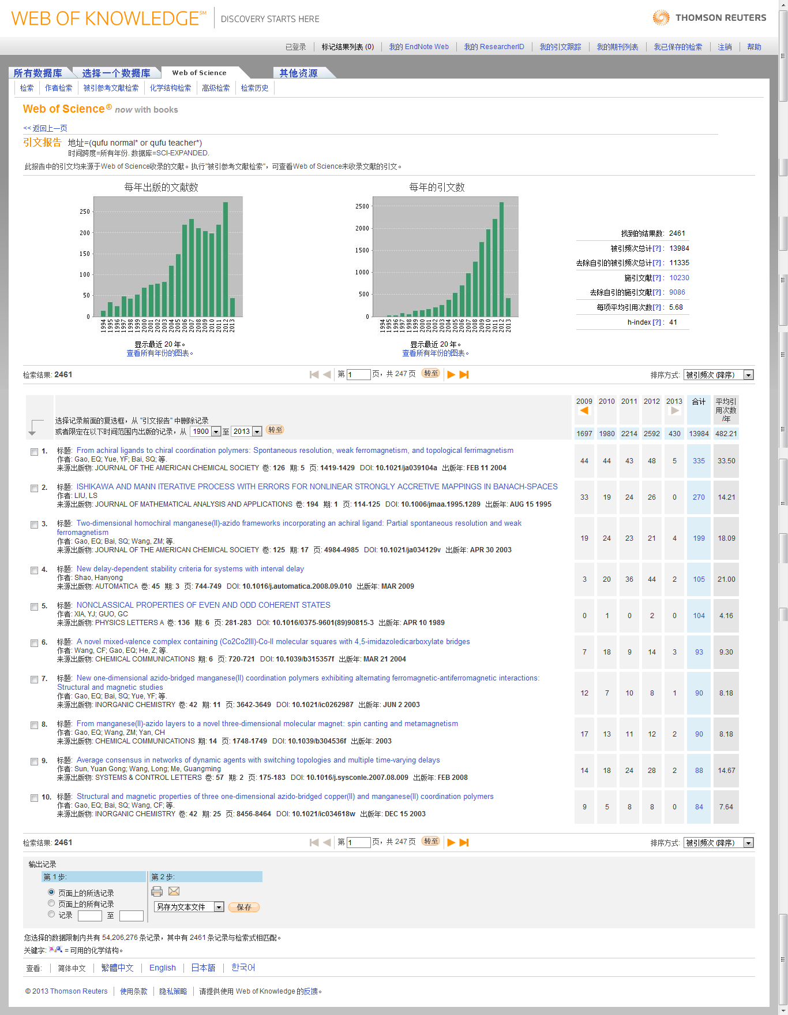
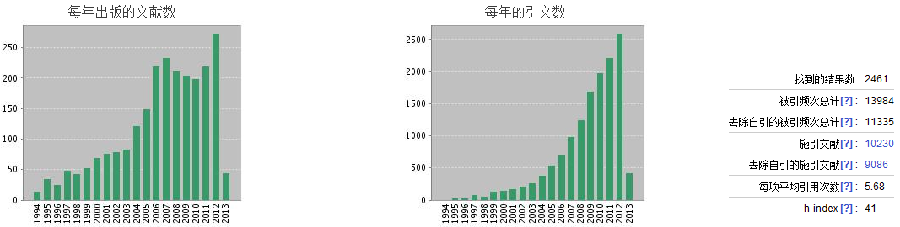
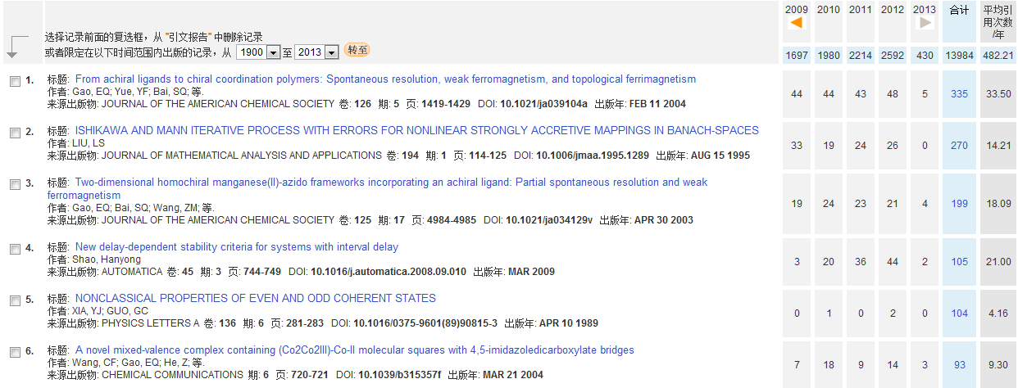

Slide 8
分析检索结果
1981-今，曲阜师范大学发表的论文中有近2461篇被SCI收录

Slide 9
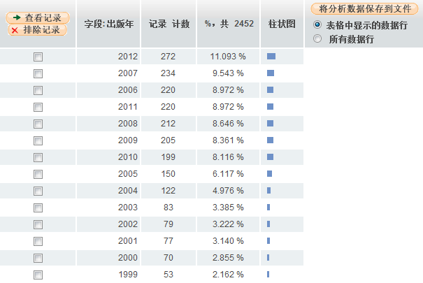
曲阜师范大学SCI论文逐年发表数量

Slide 10
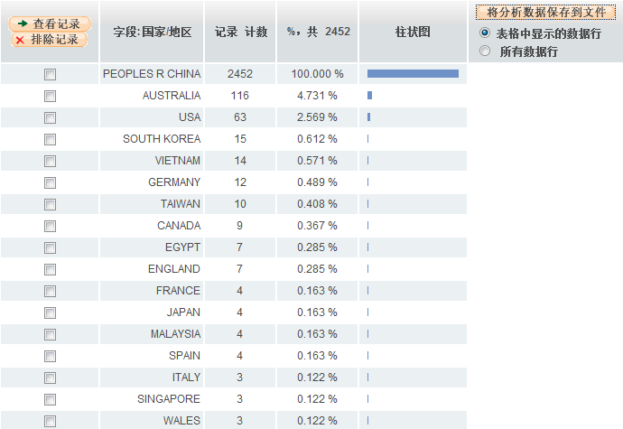
与曲阜师范大学合作发表论文的国家和地区

Slide 11
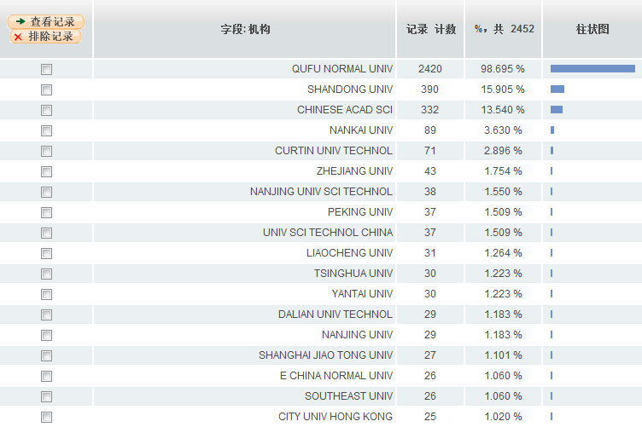
与曲阜师范大学合作发表论文的科研机构

Slide 12
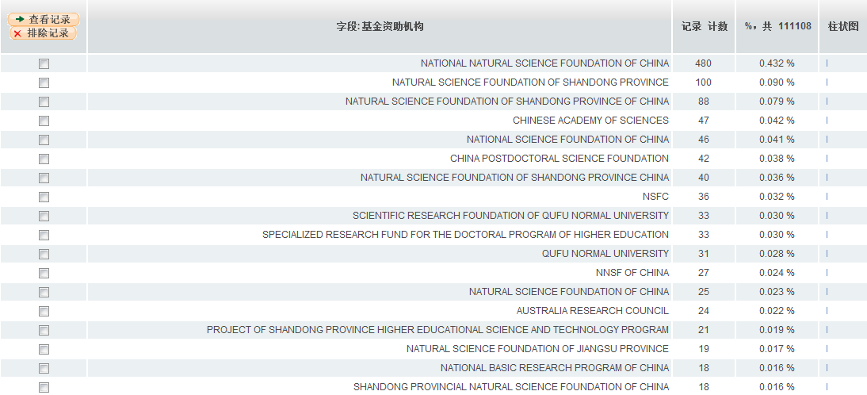
曲阜师范大学发表论文的主要资助基金

Slide 13
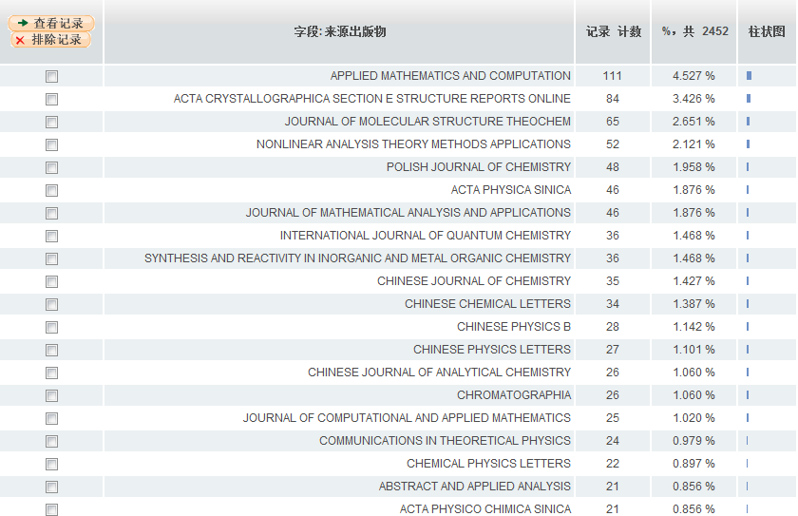
曲阜师范大学学术论文发表较多的期刊

Slide 14
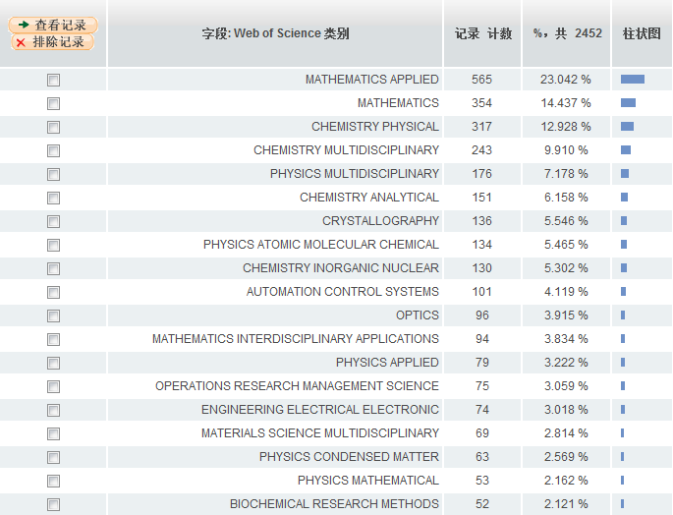
曲阜师范大学发表论文较多的科研领域

Slide 15
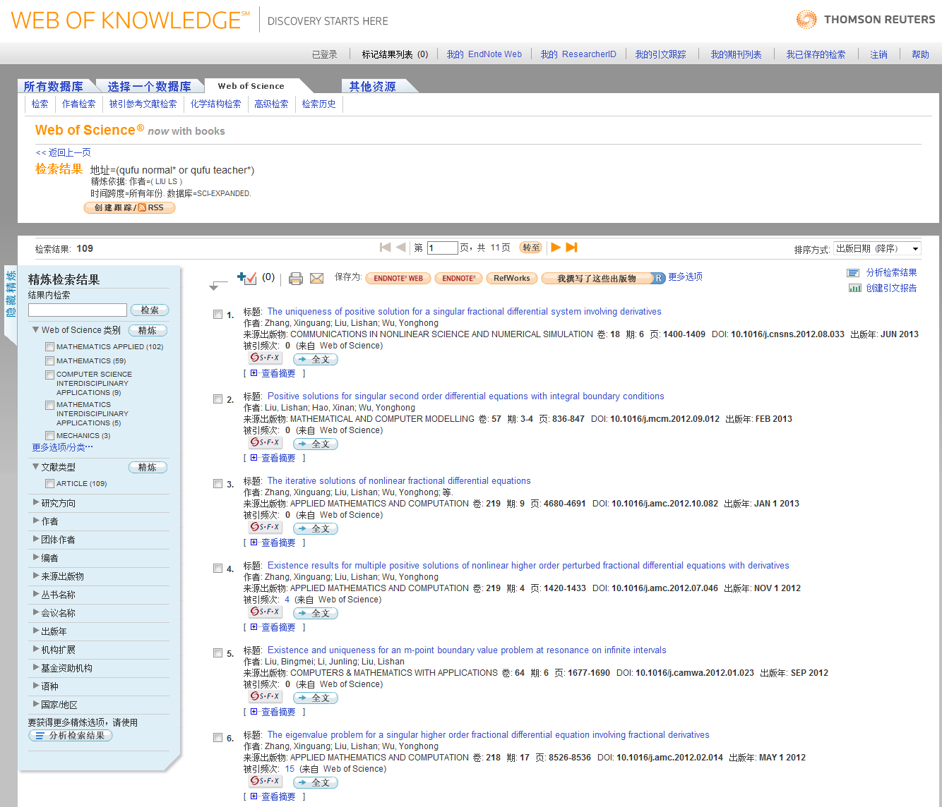
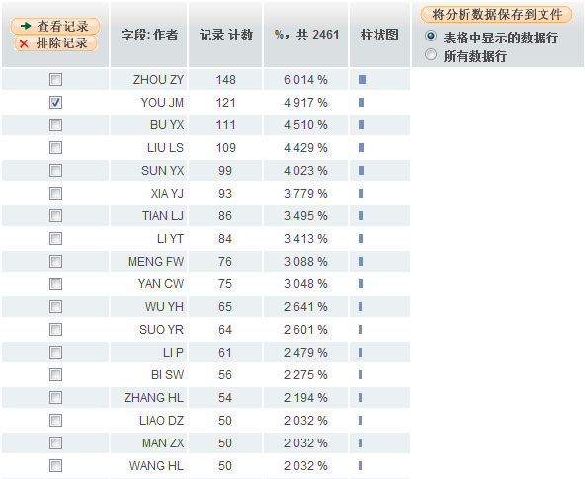
曲阜师范大学发文量较高的科研人员

Slide 16

Question 2
Notes:
引用尤进茂老师的文章主要发表在了哪些期刊上啊？

Slide 17
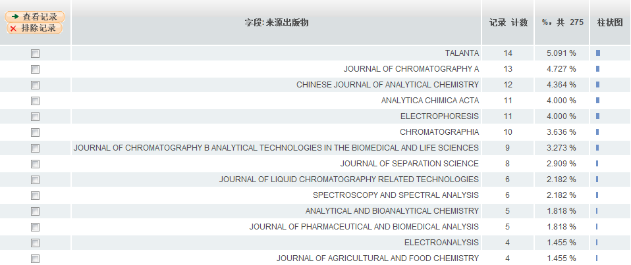
引用尤进茂老师在曲阜师范大学科研成果的论文主要发表在以下期刊：

Slide 18

Question 3
Notes:
不知道有没有同学想过毕业之后想出国留学。申请国外博士的时候经常会碰到这么一个问题，就是学校说你的背景很好，但是我们现在没有经费不招人。那我们如果自己寻找课题经费的话应该去哪里找呢？

Slide 19
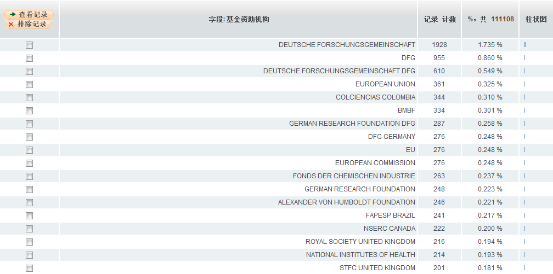
慕尼黑大学科研论文主要基金资助机构

Slide 20
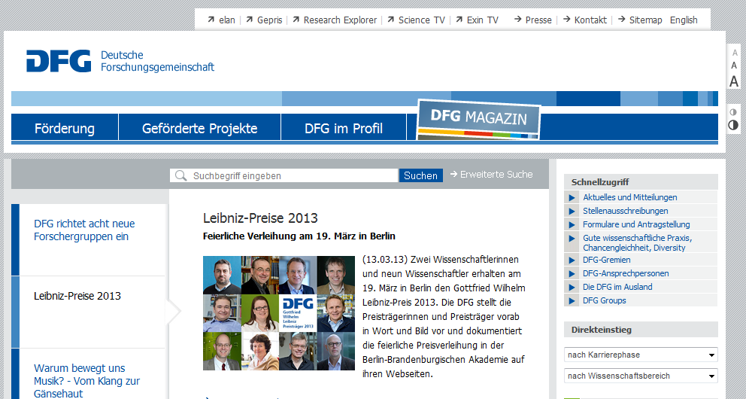
德国科学基金会

Slide 21

瑞士国家科学基金会

Slide 22

Question 4

Slide 23
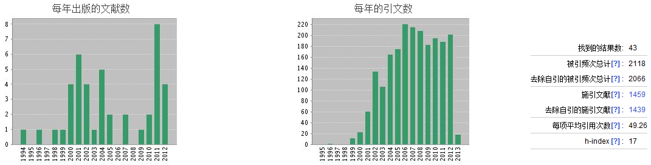
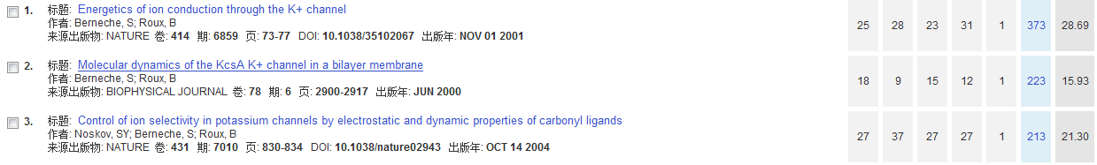
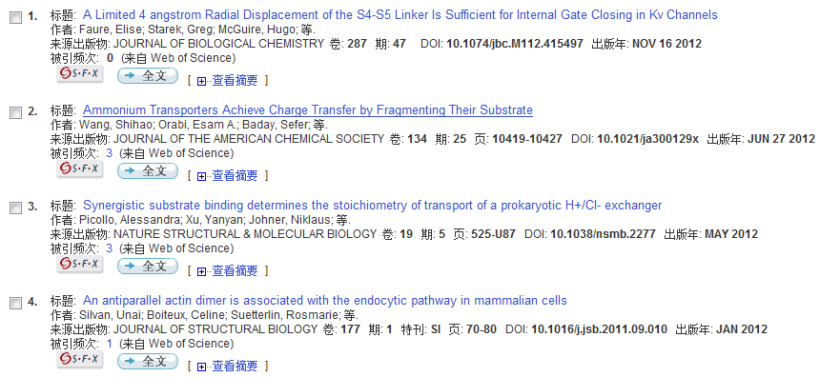

Simon Berneche
Notes:
三个方面，找导师，找科研伙伴，引进人才

Slide 24
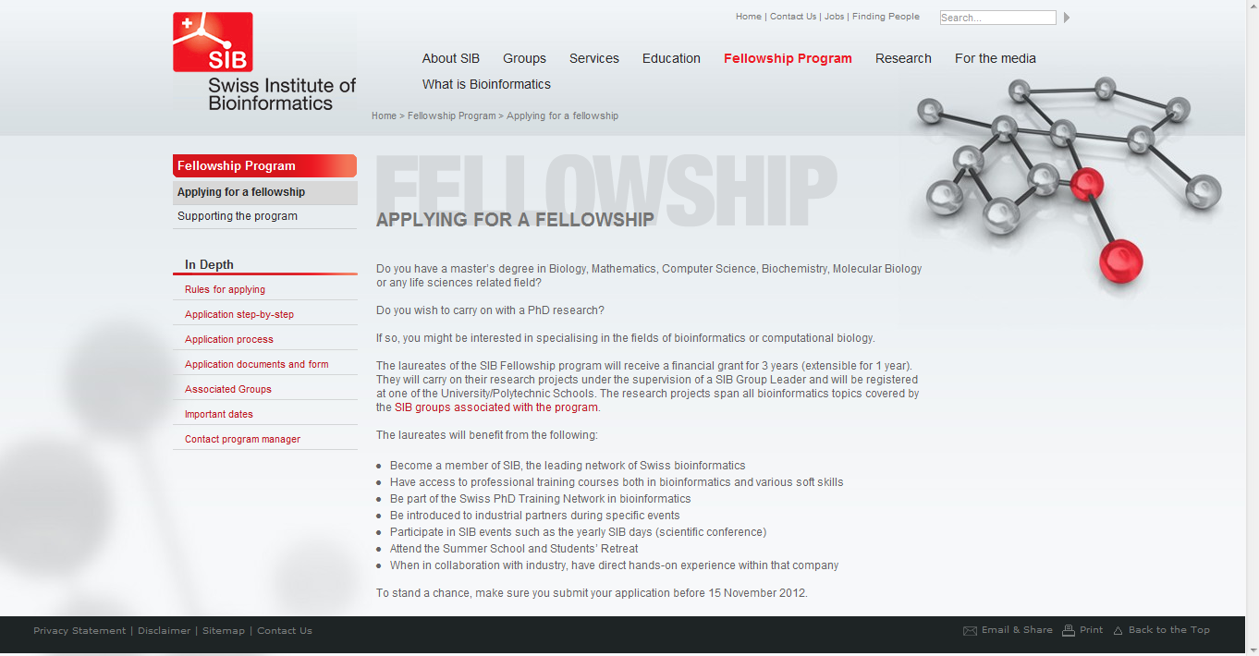
对于专业性很强的领域，国外也有很多基金

Slide 25

Question 5
Notes:
问大家了，大家在科研过程中会遇到什么问题。大家想好了可以不用举手，用意念传给我。第一条问题我已经收到了，说做实验没有课余时间，找不到漂亮的女朋友。好这个问题我会向贵校招生办的老师反映。好还有很多问题我们不一一罗列了，我之前在其他学校的讲座也收集了很多学生和老师的问题，在这里啊，我举一个如何开题查找文献的例子。

Slide 26
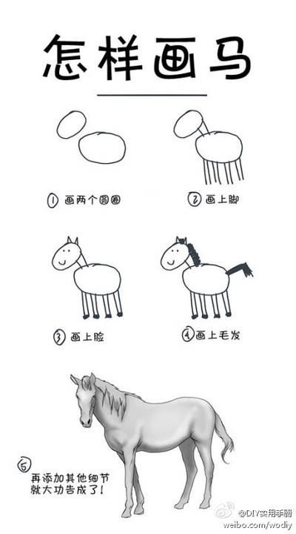

如果随便找一篇文献就读，结果也许是这样

Slide 27

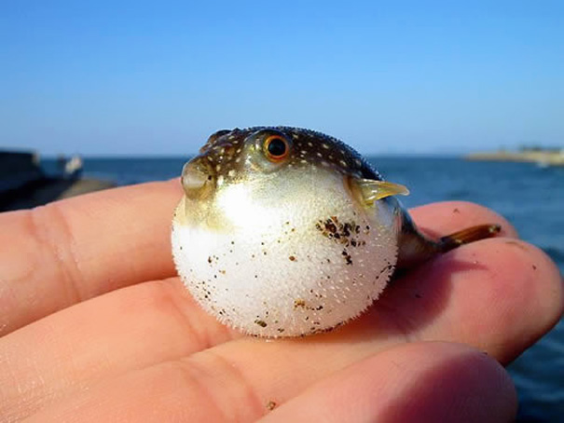
硕博士生开题选题小故事之——肥胖症

Slide 28
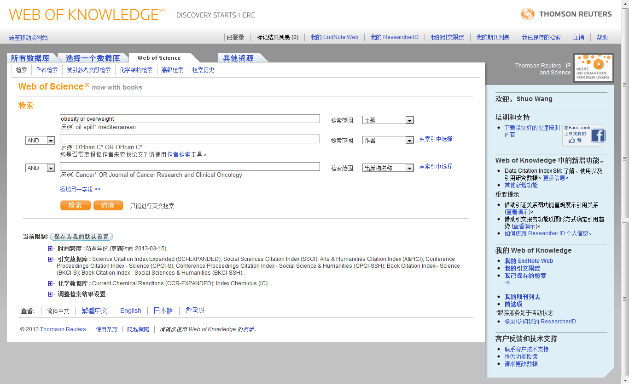
www.webofknowledge.com，输入关键词

Slide 29
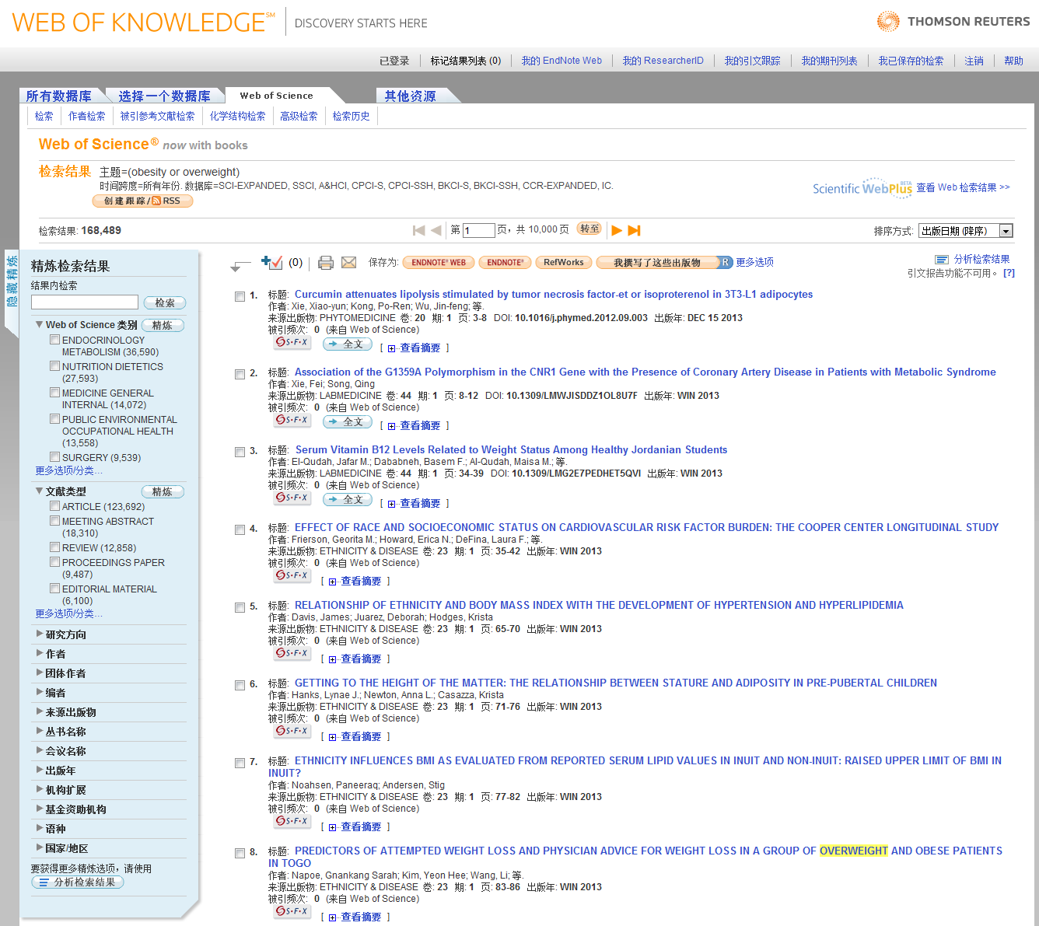
检索结果较多，先看哪些？重点看哪些？
1.精炼检索结果
2.排序检索结果
3.分析检索结果
Notes:
前一阵子听一个同学和我说，看文献碰到的最悲剧的事情不是一片文献看不懂，而是发现看到一片文献题目，觉得还不错准备下载的时候，系统提示说文件已存在。

Slide 30
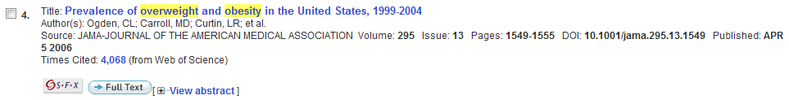
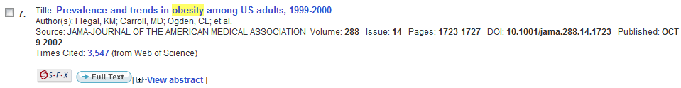
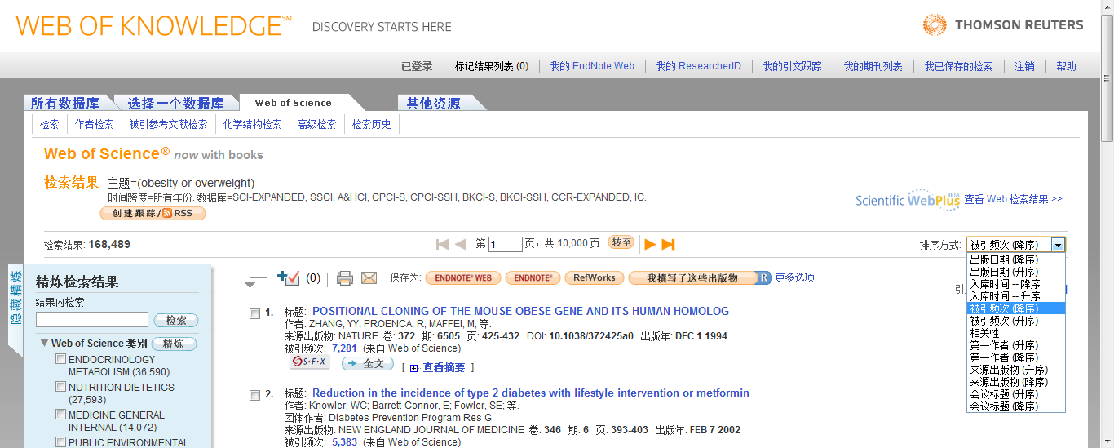

Slide 31
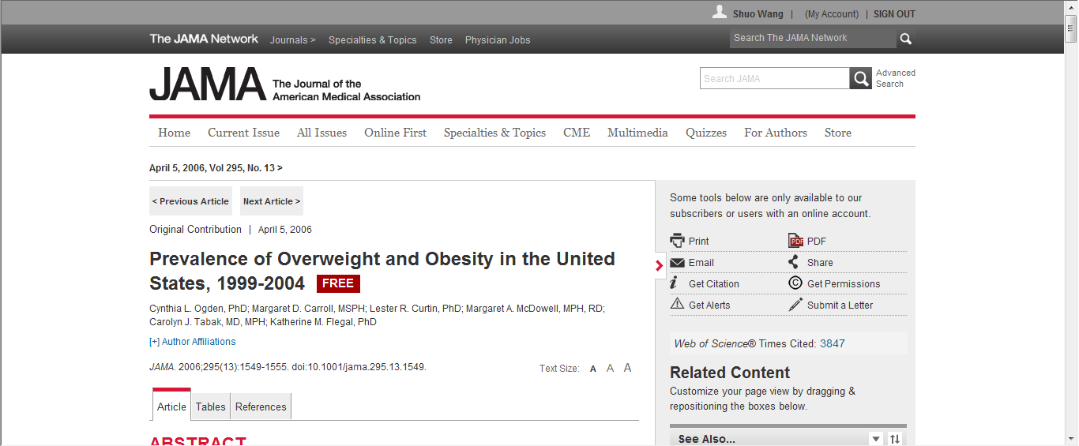
近年来，xxx越来越受到关注/xxx问题愈发严峻/一些报告指出……

Slide 32
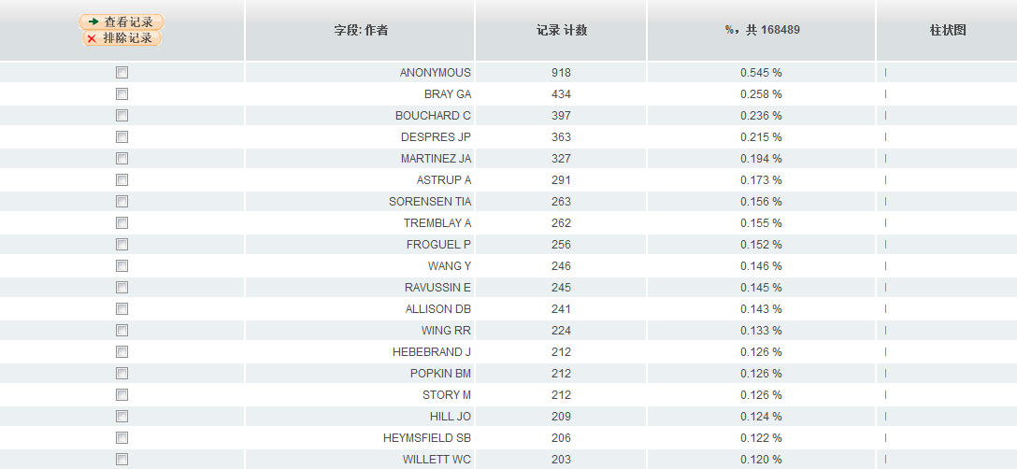
作者检索：发文量大的科研人员
Notes:
可以看到这几个作者啊，有点印象，之后还有他们的事情

Slide 33
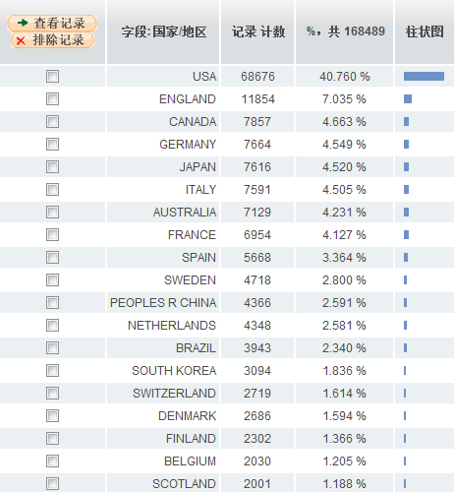
国家和地区检索：
Notes:
美国领先幅度比较大，中国暂时排在第11位

Slide 34
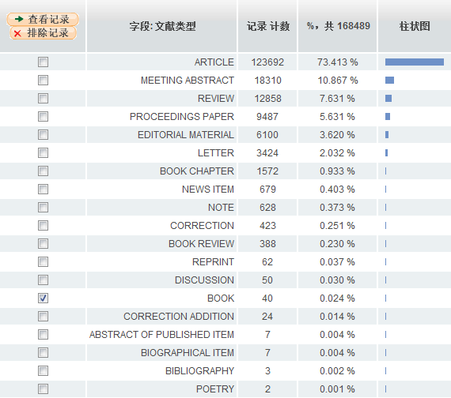
文章类型检索：除了Article和Review之外，还有Book

Slide 35
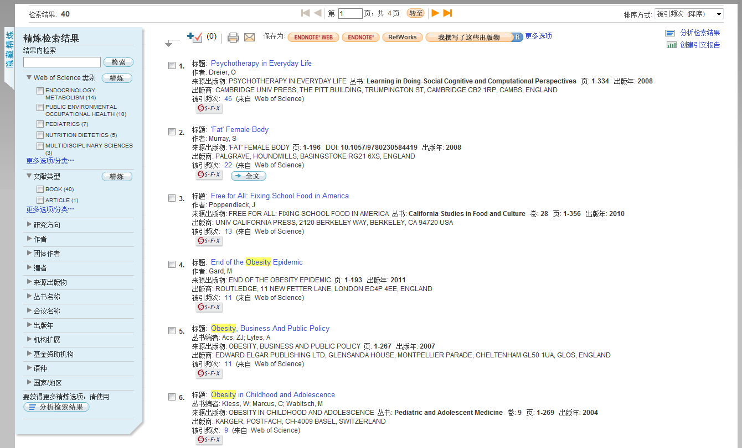
相对于Article，书籍内容更全面系统
Notes:
可以看到书籍也体现了交叉学科的发展趋势，肥胖症不仅仅是一个病理特征，同事它和经济和政治也有非常紧密的关系

Slide 36
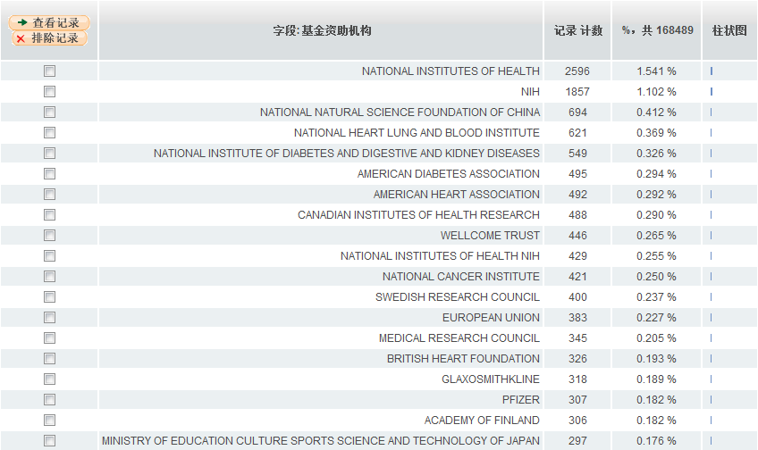
科研基金检索：
Notes:
美国国立卫生研究院，美国国家心肺和血液研究中心，中国国家自然科学基金。除此之外，可以看到很多企业也投入了大量的资金，例如葛兰素史克，辉瑞等。补充一句想去国外读生化、药学的同学们，大的药物公司是提供很多PHD和Postdoc的fellowship的，大家可以去他们的网页上面找找。还有一个例子不知道大家有没有听说，诺基亚获得欧盟13.5亿美元经费研究石墨烯。为学校寻找科研合作伙伴提供了一些思路。

Slide 37
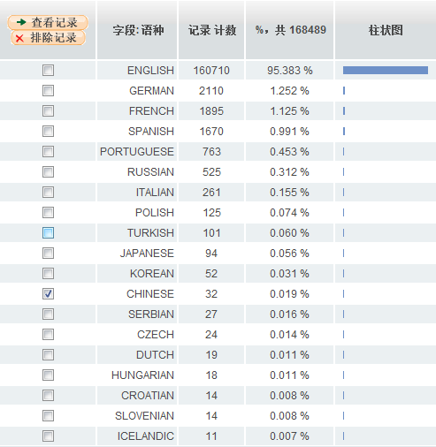
语言检索：
Notes:
可能有些同学英文基础不是很好，想快速的对这个课题有个初步的认识。也不防先看看中文的相关文献。

Slide 38
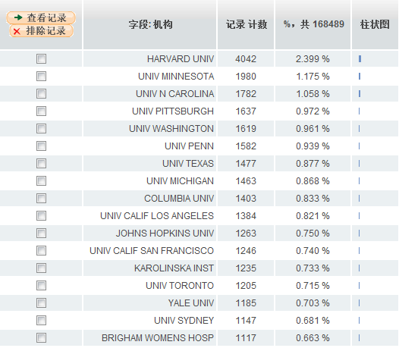
科研机构检索：为科研合作、学术交流作参考
Notes:
主要还是以国外的科研机构为主的，如何查看中国主要的科研机构呢

Slide 39
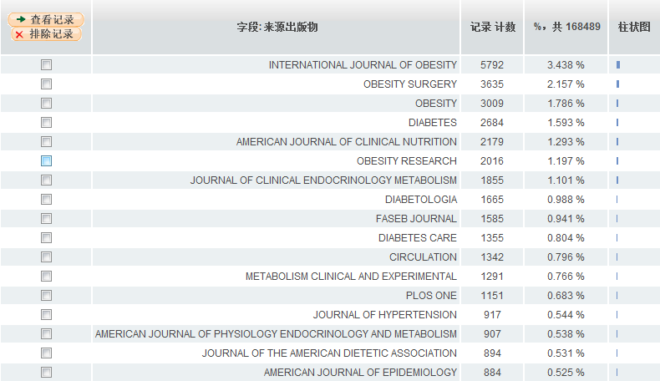
期刊检索：
Notes:
通过期刊检索结果可以查看现有的文章都发表在了哪些期刊上，为老师们投稿有一个比较直观的印象。另外如果老师在科研一开始的时候就已经有一本目标刊物，可以专门对这本期刊发表的相应课题进行分析。提高投稿的成功率。

Slide 40
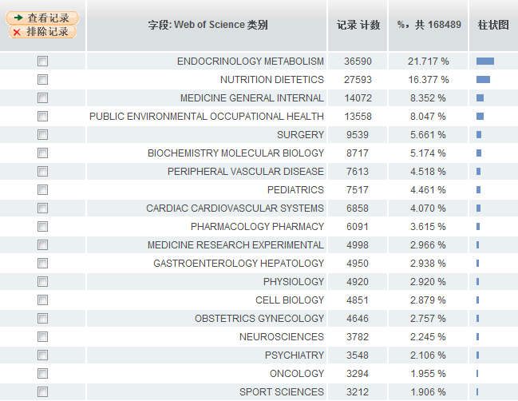
研究领域检索：
Notes:
内分泌、代谢、营养学、糖尿病、手术治疗还是比较热门的研究方向

Slide 41
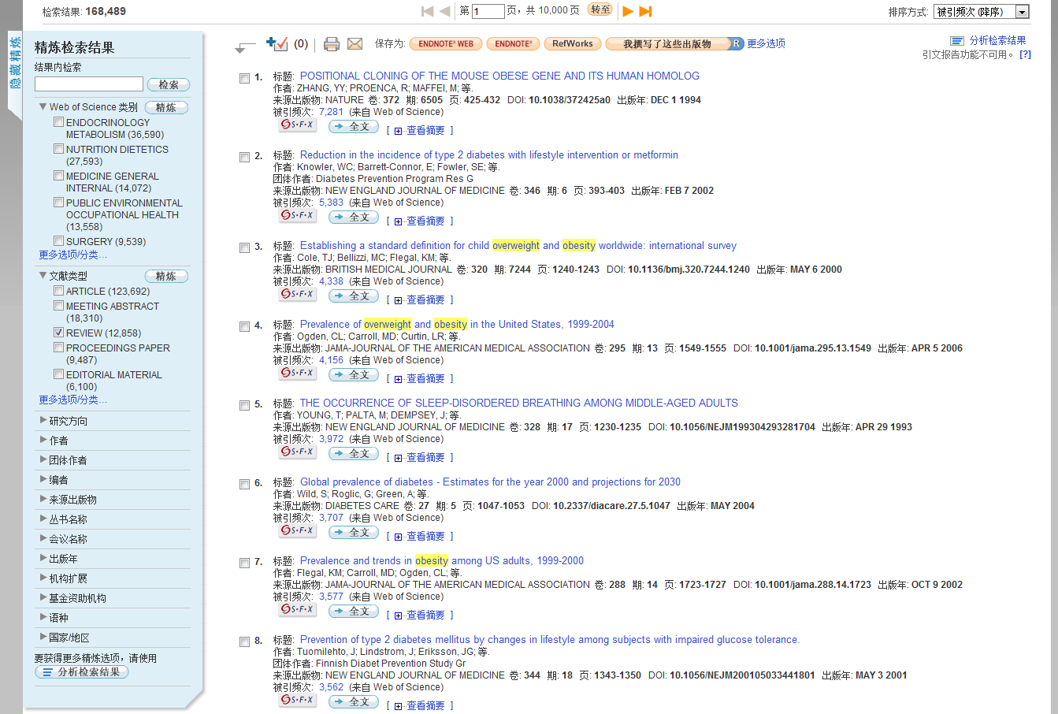
对一个研究领域有了初步印象之后，重点看一下核心科研人员写的review

Slide 42
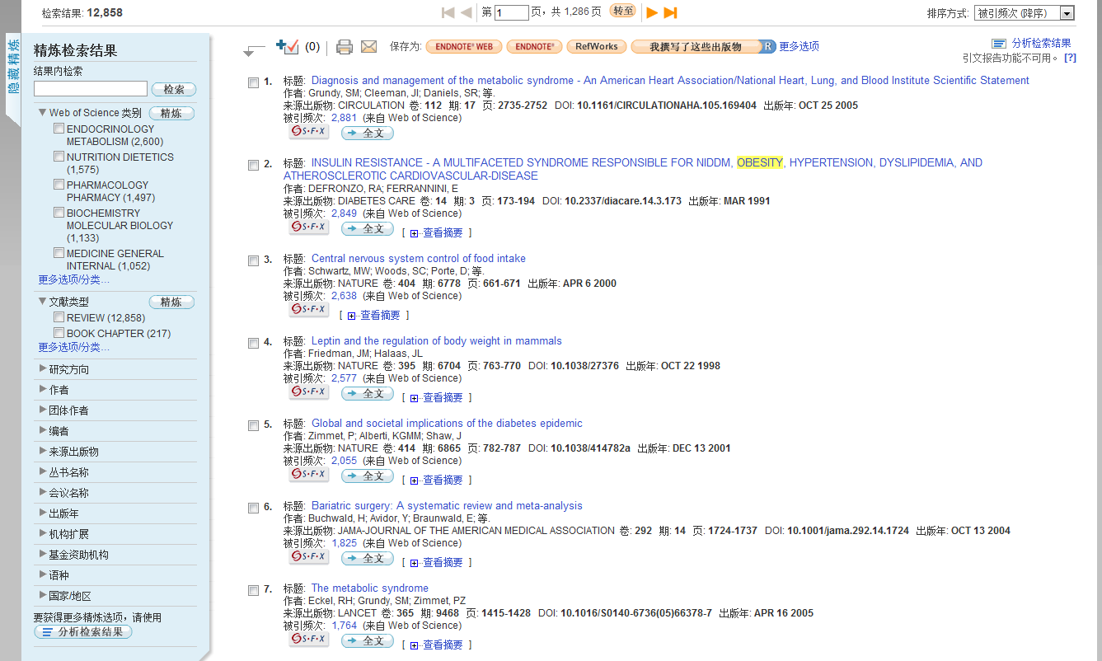
对于热门的研究课题，即使仅仅然Review数量依然很多
Notes:
1.按照被引用次数排序，可以看看高频被引文章2.再次分析检索结果

Slide 43
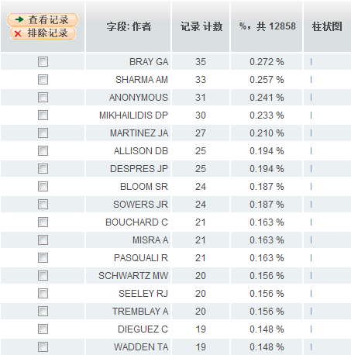
再次按照作者检索，可以看到刚才发文量较多的作者都在其中
Notes:
期刊也经常会向一个科研领域的核心研究人员来约稿。

Slide 44
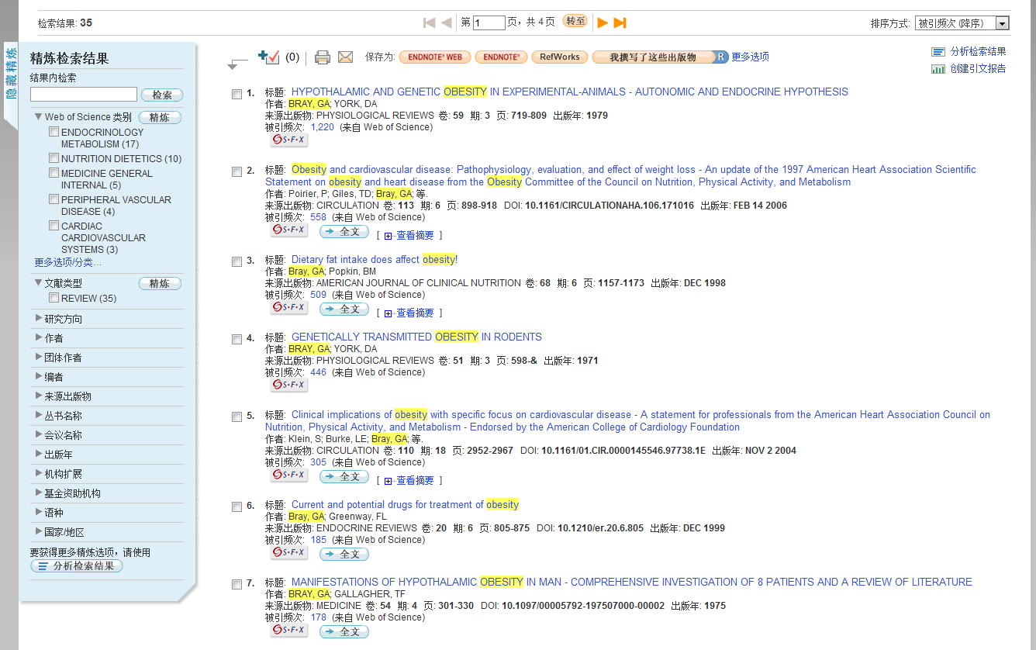
创建引文报告：从引用关系探索课题发展

Slide 45
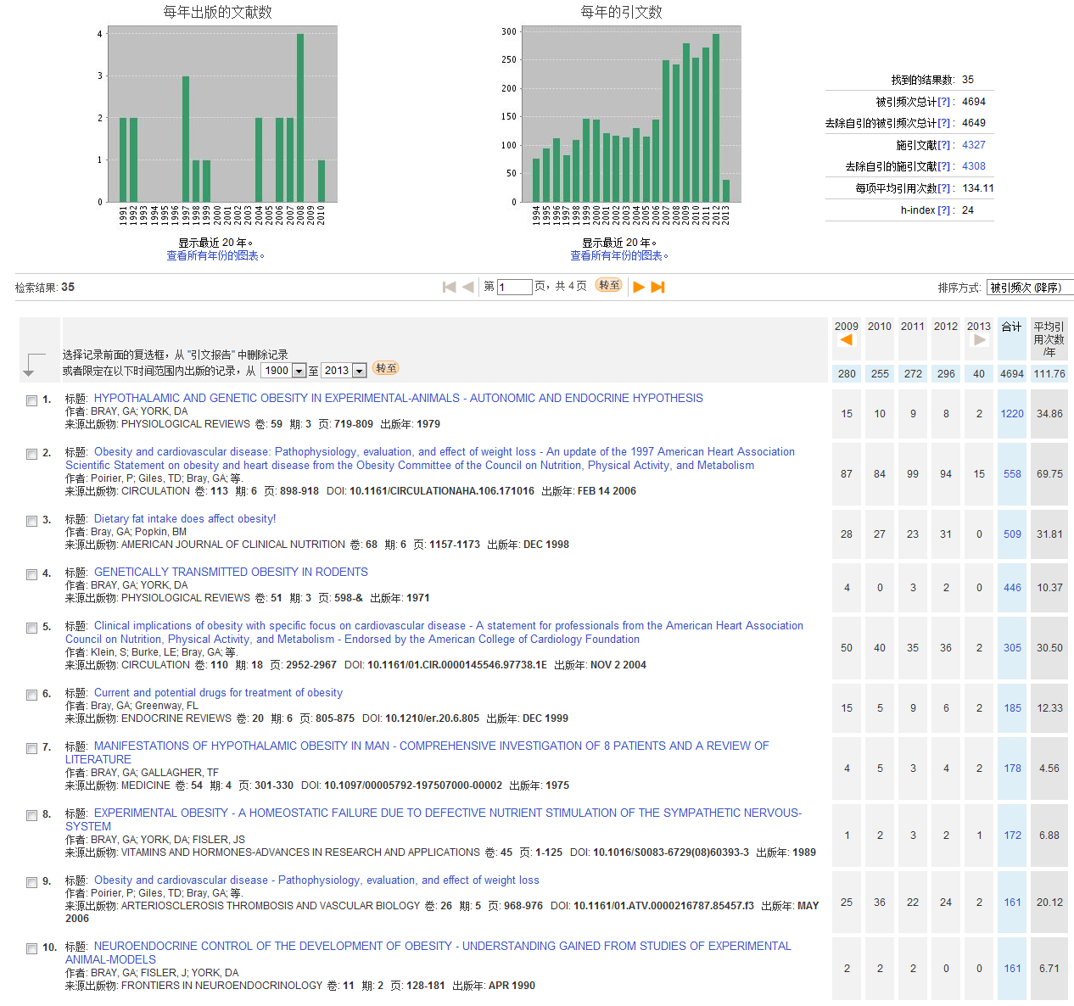
引用次数较高的论文
Notes:
核心研究人员的review会被大多数同领域的科研人员参考阅读，所以分析引用的文献就可以找到不同的科研方向。发表年限比较早且引用次数比较高的论文，通常是这个领域的经典的文章。对于了解其相关的发展是很有帮助的。相比于第一篇经典的文章，第二篇二章

Slide 46
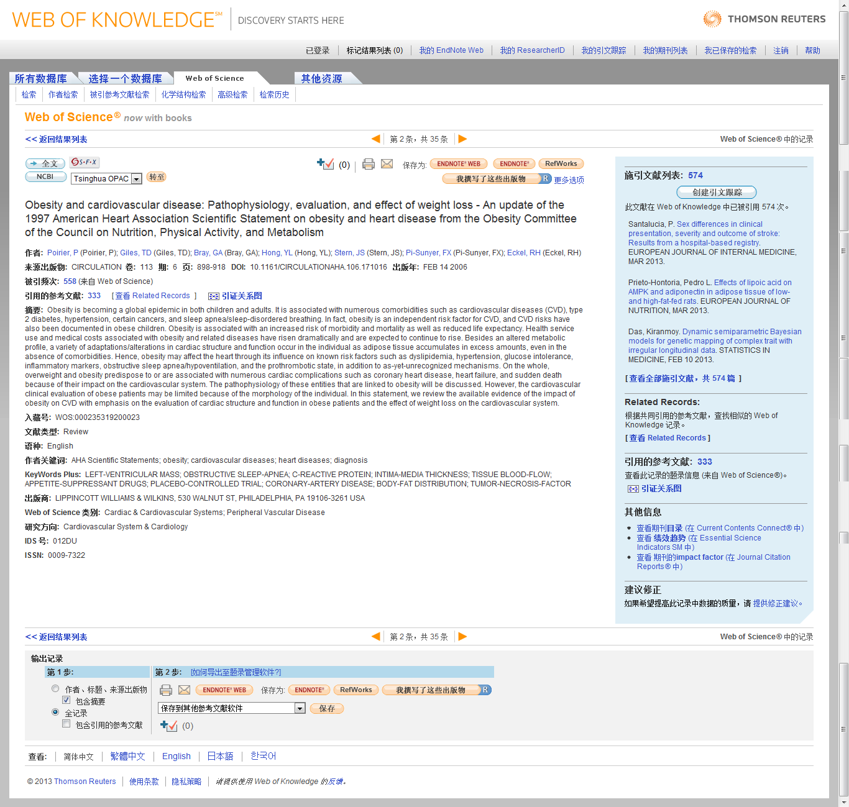
全记录界面
点击相应的记录数字就可以看这篇文献引用了哪些文献，以及被哪些文献引用
Notes:
各种功能先按下不表，重点来说一下引证关系

Slide 47
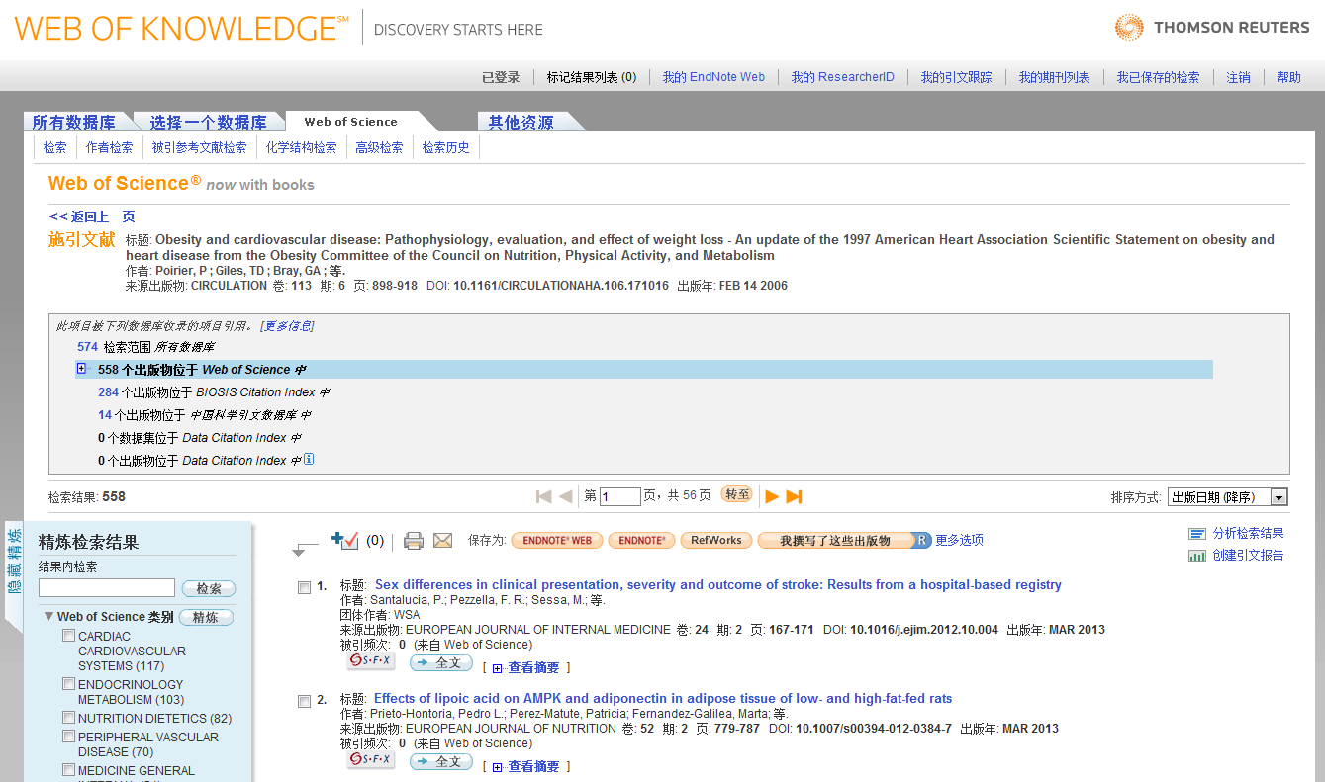
查看引用文献，再次创建引文报告

Slide 48
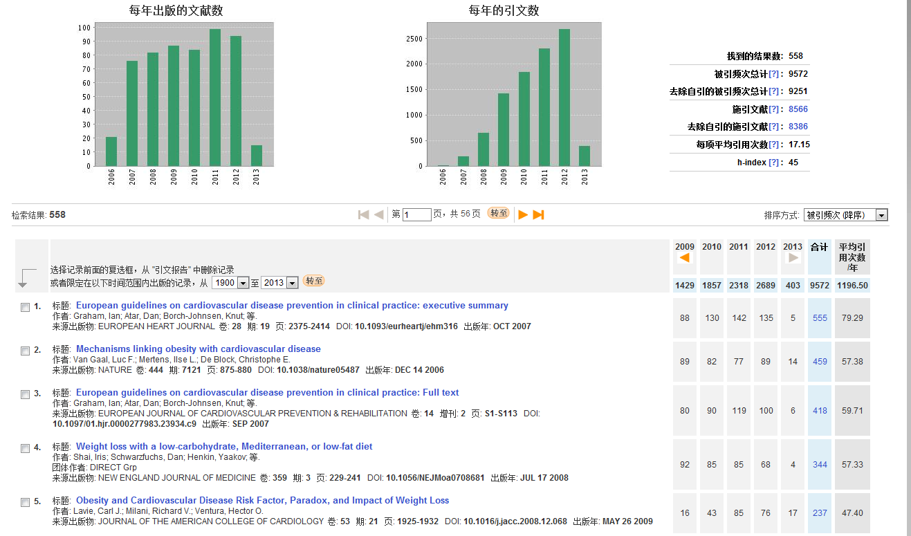
分析施引文献，得到热点研究方向一： 肥胖症与心血管疾病

Slide 49
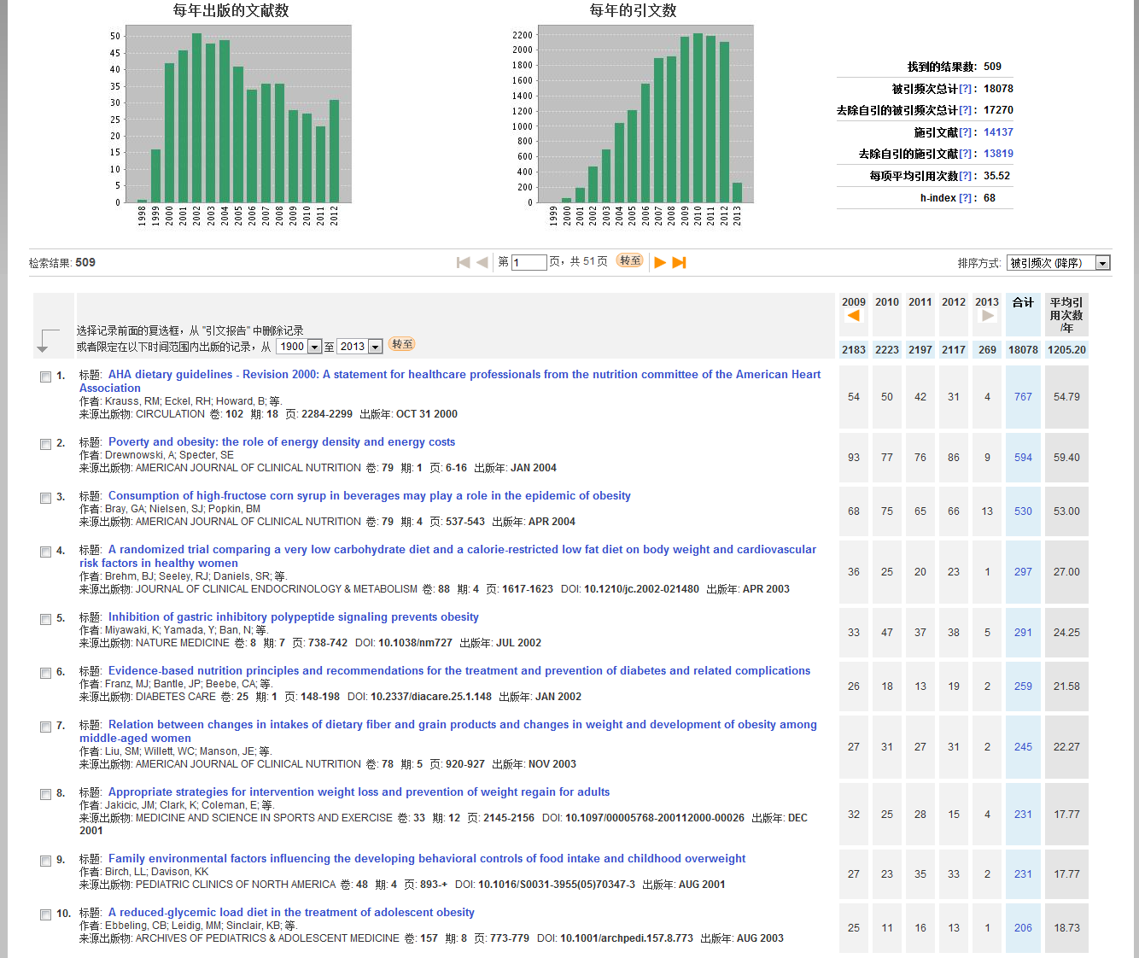
用同样的方法分析Bray另一篇高被引综述 热点研究方向二：肥胖症与食物摄取和能量转化

Slide 50
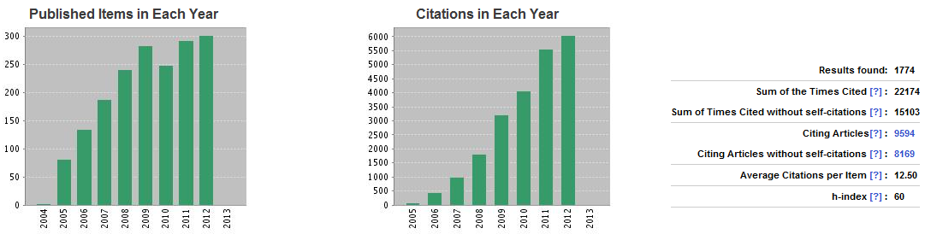
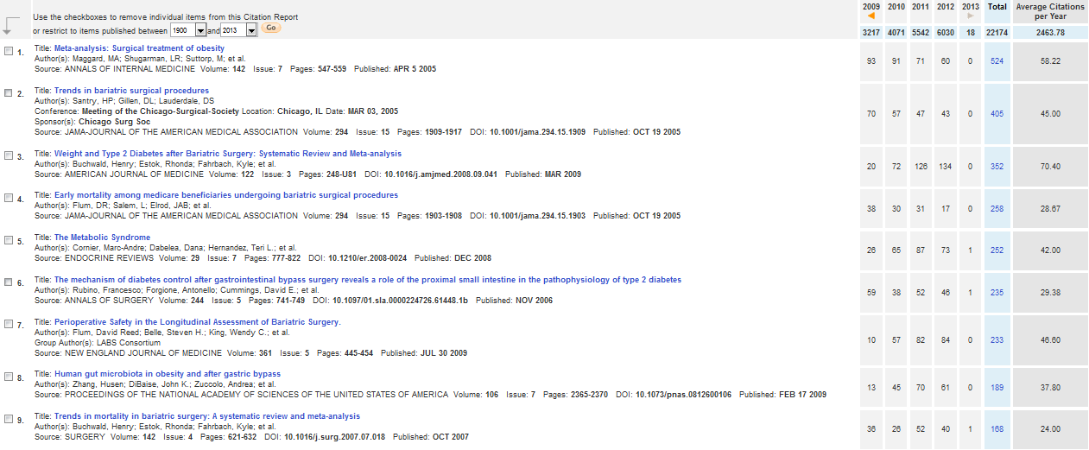
热点方向三：肥胖症与手术治疗

Slide 51

不同作者对相关领域的研究方向也存在很大差异 热点方向四：肥胖症与脂肪组织和肾素-血管紧张素系统

Slide 52

热点方向五：肥胖症与代谢综合征

Slide 53

关注名家新的热点文章，寻找领域新风向 热点研究方向六：肥胖症与含糖饮料

Slide 54


额外信息处理：肥胖与基因图谱 原作者几乎每年一篇，建议可以作为补充了解，添加在Introduction或者discussion里面，让文章更加丰满

Slide 55


在明确了大致的研究方向之后，再更换主题词进行第二轮搜索
Notes:
例如，我想看看近五年内，关于肥胖症治疗的相关文献

Slide 56
关于开题的小结
对于刚刚接触的一个方向，查文献建议把相似研究领域的文献分组
在刚才的几组文献中，有些文献出现了好几次。这类重点文献建议仔细阅读
找到自己感兴趣的方向后，再来做新的一轮分析

Slide 57
挖掘Web of Knowledge平台更进一步的功能
创建引文跟踪/定题跟踪
相关记录
引证关系图
高级检索
Endnote Web
期刊影响因子
ESI

Slide 58

再次回到一篇文献全记录界面
Notes:
什么最吸引我呢，就是这个投稿人的邮箱。

Slide 59

免费注册账户信息

Slide 60

如果是已经登录的状态，系统就会直接创建引文跟踪了

Slide 61

随时修改自己的引文跟踪

Slide 62


Slide 63

创建定题跟踪

Slide 64

输入电子邮件地址

Slide 65
查看相关记录

Slide 66
如何理解Web of Science中的相关记录呢？
论文甲
论文乙
Synthesis of Amino Acids
Synthesis of Amino Acids
Synthesis and/or collection of Synthesis and/or collection of amino acids is critical for cell survival. They not only serve as the building blocks for proteins but also as starting points for the synthesis of many important cellular molecules including vitamins and nucleotides.
Synthesis and/or collection of Synthesis and/or collection of amino acids is critical for cell survival. They not only serve as the building blocks for proteins but also as starting points for the synthesis of many important cellular molecules including vitamins and nucleotides.
Synthesis of Amino Acids
Synthesis of Amino Acids
Synthesis of Amino Acids
Synthesis of Amino Acids
Synthesis of Amino Acids
Synthesis of Amino Acids
Synthesis and/or collection of Synthesis and/or collection of amino acids is critical for cell survival. They not only serve as the building blocks for proteins but also as starting points for the synthesis of many important cellular molecules including vitamins and nucleotides.
Synthesis and/or collection of Synthesis and/or collection of amino acids is critical for cell survival. They not only serve as the building blocks for proteins but also as starting points for the synthesis of many important cellular molecules including vitamins and nucleotides.
Synthesis and/or collection of Synthesis and/or collection of amino acids is critical for cell survival. They not only serve as the building blocks for proteins but also as starting points for the synthesis of many important cellular molecules including vitamins and nucleotides.
Synthesis and/or collection of Synthesis and/or collection of amino acids is critical for cell survival. They not only serve as the building blocks for proteins but also as starting points for the synthesis of many important cellular molecules including vitamins and nucleotides.
Synthesis and/or collection of Synthesis and/or collection of amino acids is critical for cell survival. They not only serve as the building blocks for proteins but also as starting points for the synthesis of many important cellular molecules including vitamins and nucleotides.
Synthesis and/or collection of Synthesis and/or collection of amino acids is critical for cell survival. They not only serve as the building blocks for proteins but also as starting points for the synthesis of many important cellular molecules including vitamins and nucleotides.
A B C D E F
Notes:
一些非热点学科可能本身文献量较少，但是可以通过相关记录拓展思路。

Slide 67

将文献记录按照相关值排序

Slide 68


相关记录
一花一世界
从一篇高质量文献东西整个科研脉络
2004
…
2003
被引频次
2003
1998
2004
引用的参考文献
1995
1993
1991
2004
1980
← Citing ←
2002
被引频次：越查越新
引用的参考文献：越查越深
相关记录：越查越广
1999
1994
68
Notes:
68
讲到这里同学们对“引文”这个词有没有新的认识呢？

Slide 69
查看引证关系图

Slide 70

可以选择前后各两层的引证关系作图

Slide 71

初识引证关系图

Slide 72

图形可以随意拖动，也可已通过时间轴限定

Slide 73

通过第二层级被引用关系东西学科热点方向

Slide 74



高级检索之：被引参考文献检索

Slide 75


高级检索之：化学结构检索

Slide 76

高级检索之：实验仪器检索
我没有950MHz的核磁
我也没有动辄上万的试剂盒
我有的只是一颗对着科研事业热忱的心

Slide 77

你不会孤单，不会寂寞，有人与你同行！

Slide 78

如何保存喜欢的文章呢？
佛说，前世五百次回眸，才换来今世的擦肩而过。
遇到有缘的文章，千万不要错过……

Slide 79


登陆后，选择相应文章，点击保存为Endnote Web

Slide 80

我的Endnote Web

Slide 81

初识Endnote Web

Slide 82

Word插件实现核心应用

Slide 83

Endnote Web生成参考文献指南

Slide 84

Endnote Web生成参考文献指南

Slide 85

Endnote Web生成参考文献指南

Slide 86

Endnote Web生成参考文献指南

Slide 87


将其他数据库中的文献记录导入到Endnote Web

Slide 88

如何使用Journal Citation Report选择期刊投稿
Notes:
请问大家一个问题，有没有同学或者老师往外文期刊投过稿件？

Slide 89

最开始的时候收到期刊的邮件总会很兴奋

Slide 90

不过有的时候啊，投稿总是被莫名其妙的拒绝掉 “您的文章……，但是本刊是……。您文章中的xxxx是非常非常出色的……”

Slide 91

第一种情况，仅仅是因为格式和行文
Notes:
很多期刊对于咱们中国作者英文的一些遣词造句颇有微词，另外可能是看最后的引文格式不对，或者是引用的文献水平较低。他会委婉的用其他利理由来拒绝掉你。建议大家多读一些英文的文献，我在做毕设的时候导师给我的任务就是每天精读10篇相关文献，每周要向他做文献汇报。开始的时候非常的痛苦，但是最后写文章的时候却很感谢我的老师，因为他的要求，行文的时候不再一字一句的用google翻译，那种写英语套话的本领强了不少。

Slide 92

第二种情况，就是真正的和他认为的读者群体关注度有所偏差

Slide 93

进入JCR方法1

Slide 94
进入JCR方法2

Slide 95

Impact Factor（期刊影响因子）逐年变化趋势

Slide 96

期刊的全纪录界面
期刊之间的引用
和被引用关系
相关期刊
每年出版数量

Slide 97

按照相关性将期刊排序
Notes:
并不限于说我的文章被拒绝了我再看去投什么文章，而是说一开始的时候我实验室发了什么什么期刊。我就要选定几个目标

Slide 98

期刊的全纪录界面

Slide 99

查看有关学科“外周血管疾病”的期刊
按照IF由高到低排序
Notes:
从另一个角度告诉老师们应该如何选刊

Slide 100

对于科研管理人员，如何分析评价科研成果呢？

Slide 101

ESI（Essential Science Indicators）

Slide 102


Slide 103
ESI（Essential Science Indicators）

Slide 104

曲阜师范大学进入ESI的学科情况

Slide 105


两ESI学科具体排名
Chemistry：995
Engineering: 849

Slide 106


曲阜师范大学的Highly Cited Papers/Top Papers
Highly Cited Papers: 20
1% within 10 years
Hot Papers: 5
1‰ within 2 years

Slide 107

在Web of Knowledge的大家庭里……
有着更多的功能，等待着您的探索和发现

Slide 108



学习资源，网址http://ip-science.thomsonreuters.com.cn/
汤森路透所有数据库的使用课件
汤森路透大讲堂课程资源

Slide 109



模块一：汤森路透春季大讲堂
网址：http://ip-science.thomsonreuters.com.cn/2013wokonline/courses.htm
开题选题
英文论文写作与投稿技巧
基金申请
专利

Slide 110



模块二：中科大讲师团
网址：http://ip-science.thomsonreuters.com.cn/2013WOKOnline/resource_web.htm
搜索引擎与网络学习（桌面搜索）
数据库资源的发展趋势和利用
RSS-同步追踪世界最新资讯
个人知识管理WIZ
手把手教你用EndnoteX6
文件管理新境界-TC简介
HistCite-快速定位核心文献
思维导图及其在科研中的应用

Slide 111
已经开通Web of Science的师范类高校
北京师范大学 | 首都师范大学 | 陕西师范大学
浙江师范大学 | 杭州师范大学 | 云南师范大学
福建师范大学 | 上海师范大学 | 华中师范大学
南京师范大学 | 江西师范大学 | 东北师范大学
广西师范大学 | 华南师范大学 | 华东师范大学
湖南师范大学 | 河南师范大学

Slide 112
我校也已经开通Web of Science试用
试用时间：03月28日-04月27日
授权内容：Web of Science ， ESI
登录地址：http//webofknowledge.com
中国地区技术/使用问题支持：
E-Mail：ts.support.china@thomsonreuters.com
Phone： 4008 822 031
培训和视频教学资料：
http://ip-science.thomsonreuters.com.cn/2013WOKOnline
人人网公共主页：
http://www.renren.com/99411739
Web of Knowledge大讲堂微博群
http://q.weibo.com/569008
Notes:
112

Slide 113
Thank you for your attention!
王硕 汤森路透集团
手机：187-1007-8551
座机：010-5760-1223
邮箱：s.wang@thomsonreuters.com
QQ：494938351

